Slide 1
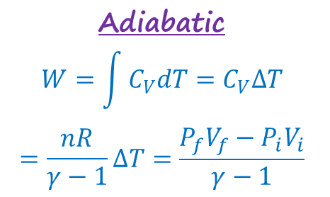
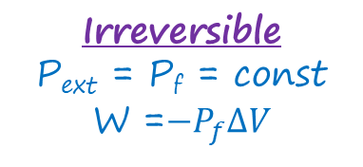
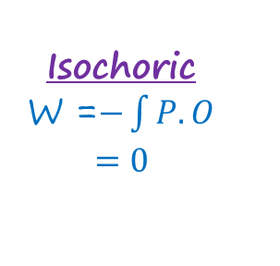
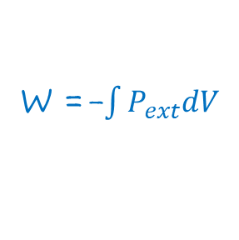
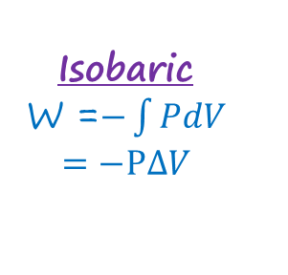
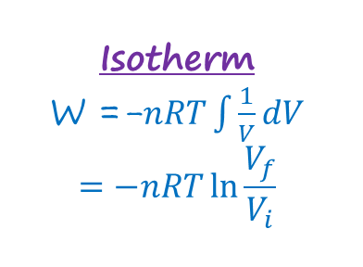
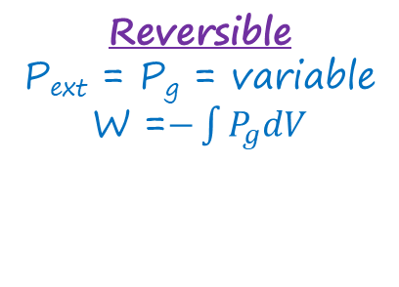
W =-$\int{P_{ext}dV}$
Irreversible
P_{ext} = P_{f} = const
W =$−P_{f}∆V$
Reversible
P_{ext} = P_{g} = variable
W =$−\int{P_{g}dV}$
Isotherm
W =-$nRT\int{\frac{1}{V}dV}$
$$=−nRT\ln{\frac{V_{f}}{V_{i}}}$$
Isobaric
W =$−\int{PdV}$
$$=−P∆V$$
Isochoric
W =$−\int{P.O}$
$$=0$$
Adiabatic
$$W=\int{C_{V}dT}=C_{V}∆T$$
$$=\frac{nR}{γ−1}∆T=\frac{P_{f}V_{f}−P_{i}V_{i}}{γ−1}$$

Slide 2
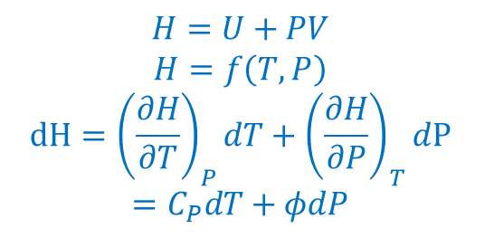
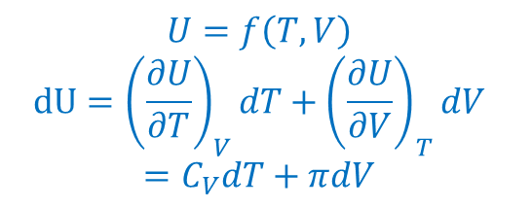
$$U=f\left(T,V\right)$$
$$dU={\left(\frac{∂U}{∂T}\right)}_{V}dT+{\left(\frac{∂U}{∂V}\right)}_{T}dV$$
$$=C_{V}dT+πdV$$
$$H=U+PV$$
$$H=f\left(T,P\right)$$
$$dH={\left(\frac{∂H}{∂T}\right)}_{P}dT+{\left(\frac{∂H}{∂P}\right)}_{T}dP$$
$$=C_{P}dT+φdP$$

Slide 3
1st law
dU = dq + dW

Slide 4
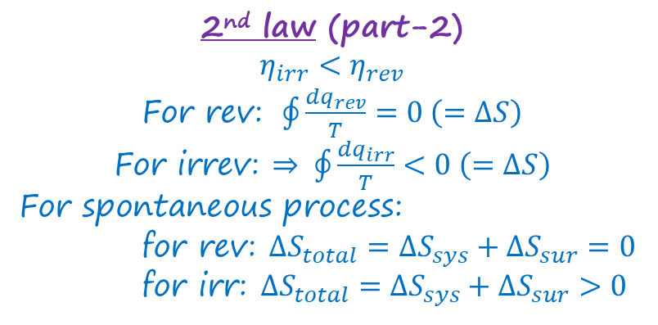
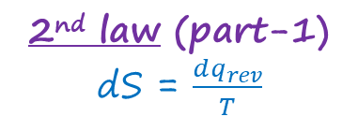
2nd law (part-1)
dS = $\frac{dq_{rev}}{T}$
2nd law (part-2)
$$η_{irr}<η_{rev}$$
For rev: $\oint{\frac{dq_{rev}}{T}}=0 \left(=∆S\right)$
For irrev: $⇒ \oint{\frac{dq_{irr}}{T}}<0 \left(=∆S\right)$
For spontaneous process:
for rev: $∆S_{total}=∆S_{sys}+∆S_{sur}=0$
for irr: $∆S_{total}=∆S_{sys}+∆S_{sur}>0$

